Slide 1

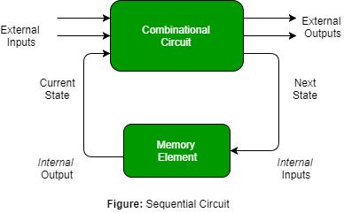

Combinational Circuit / Sequential Circuit

Slide 2
Combinational Circuit

Slide 3
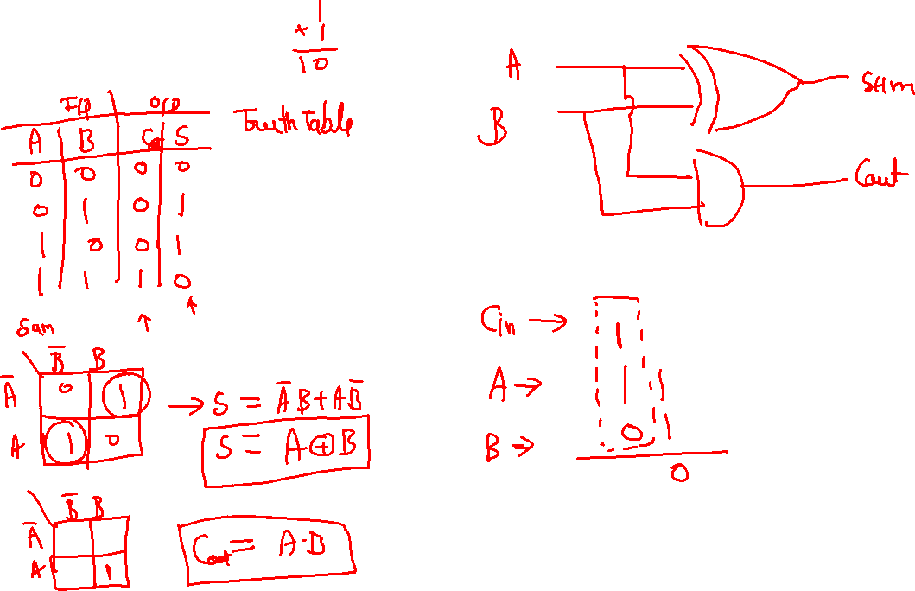
Half Adder

Slide 4
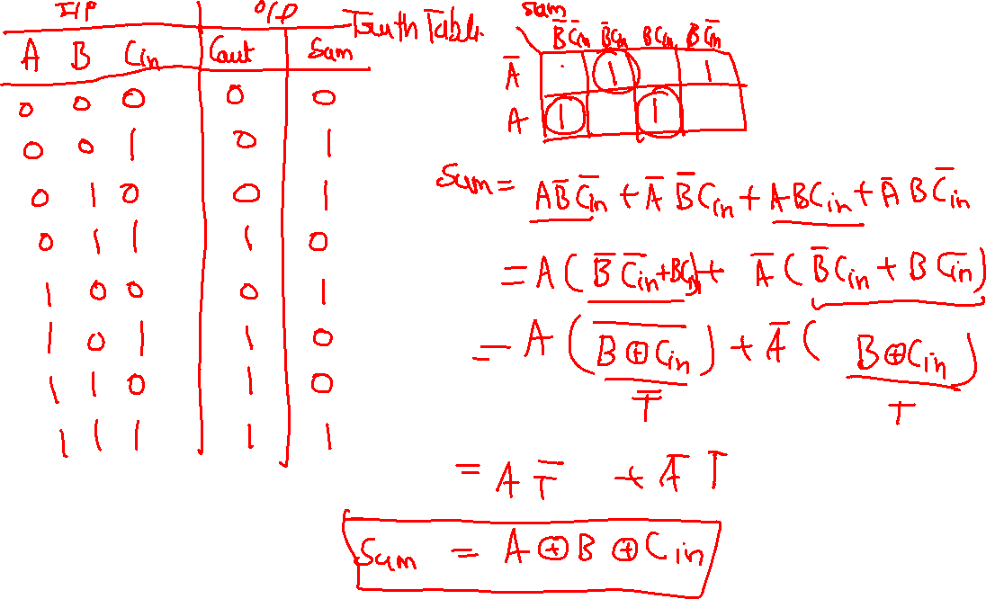

Slide 5
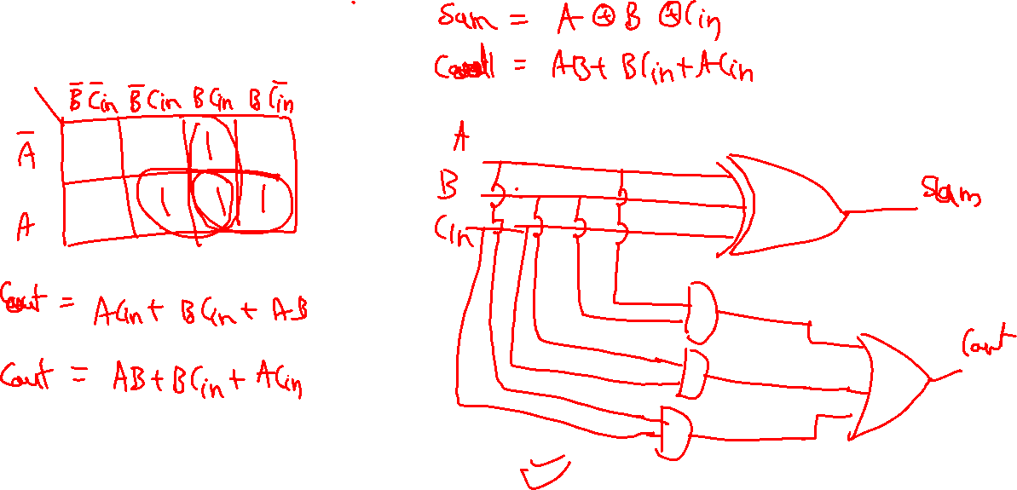
Full Adder

Slide 6
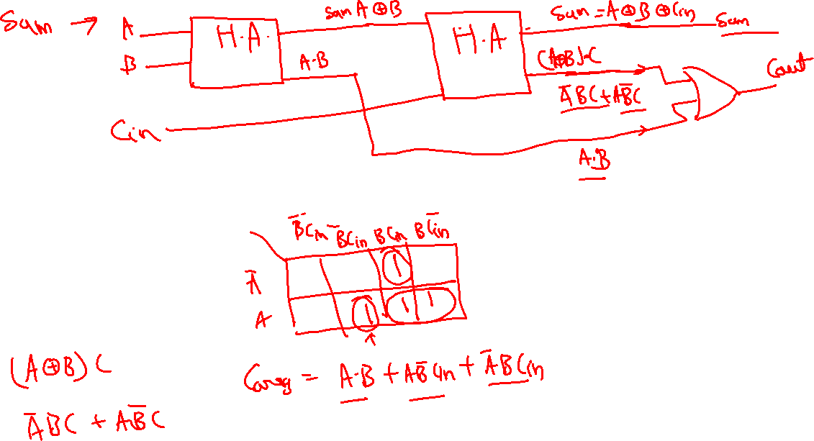

Slide 7
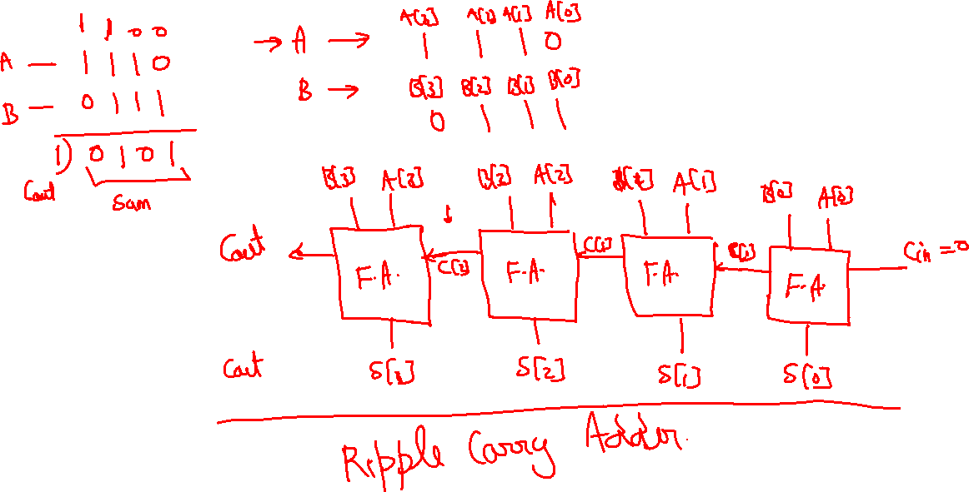

Slide 8
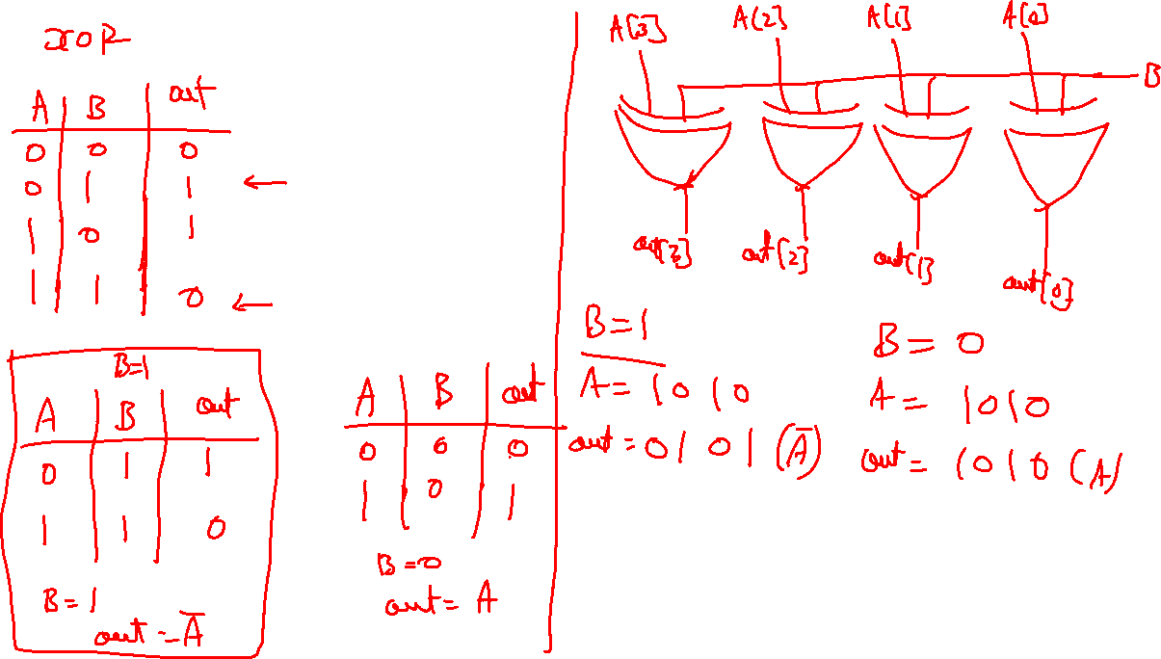

Slide 9
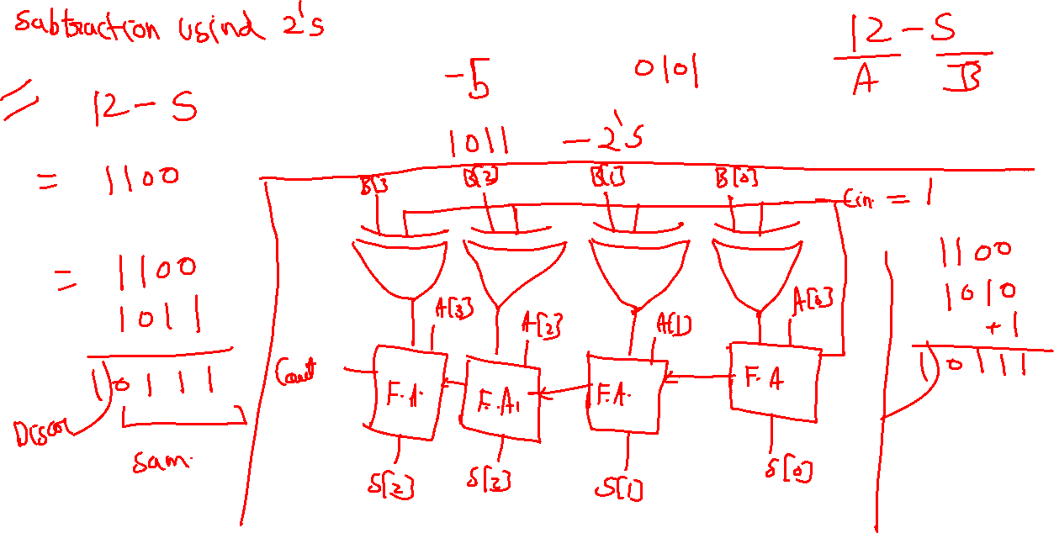

Slide 10
Ripple carry adder

Slide 11
Adder subtractor

Slide 14
Carry look ahead adder

